Slide 1
Support for Research Data Management at Salford
Hannah Baker
July 2015

Slide 2
Pilot Research Data Management Service
Infrastructure to store and share data (for EPSRC funded researchers only)
Policy
Support

Slide 3





Pilot Infrastructure
4 systems for data management throughout the data lifecycle

Slide 4
Infrastructure
Non-EPSRC researchers
Alternative storage allocated from IT Services
Guidance on external data repositories and journals for publishing
Goal = provide data storage, sharing and publishing facilities for all researchers once pilot has been evaluated

Slide 5
Draft Policy
In consultation
Mandatory for EPSRC funded researchers
Aspirational for all others until the infrastructure is available
“Every research project should produce a Data Management Plan (DMP) before the project commences, or prior to submission of a grant application”

Slide 6
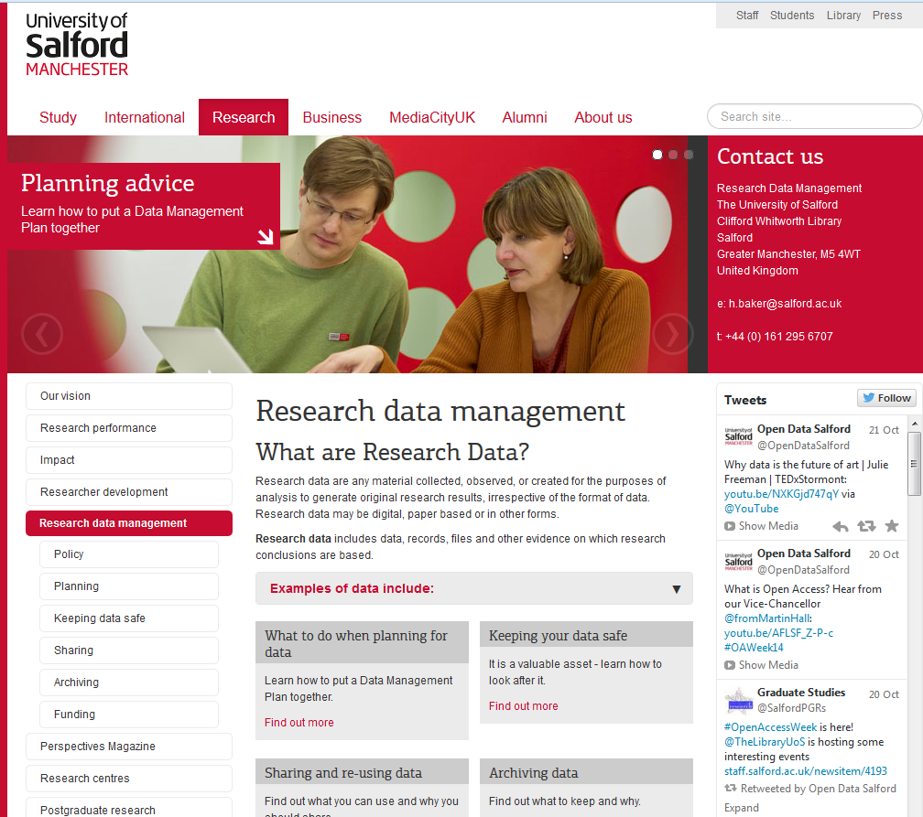

Existing Support
@OpenDataSalford
Enquiry Service:
E: researchdata@salford.ac.uk
P: 0161 295 6707
www.salford.ac.uk/rdm
Notes:
Developing support and training over the next year – online materials and activities, blogs and forums, enquiry service but for those keen to get started already there is some online training available from the uni of Edinburgh.

Slide 7
Support in Development
Updated website in August 2015
E- learning modules on Blackboard
SPoRT Training Sessions
Other Training Sessions
RDM Champions
Notes:
Also working to include rdm into the phd student journey

Slide 8

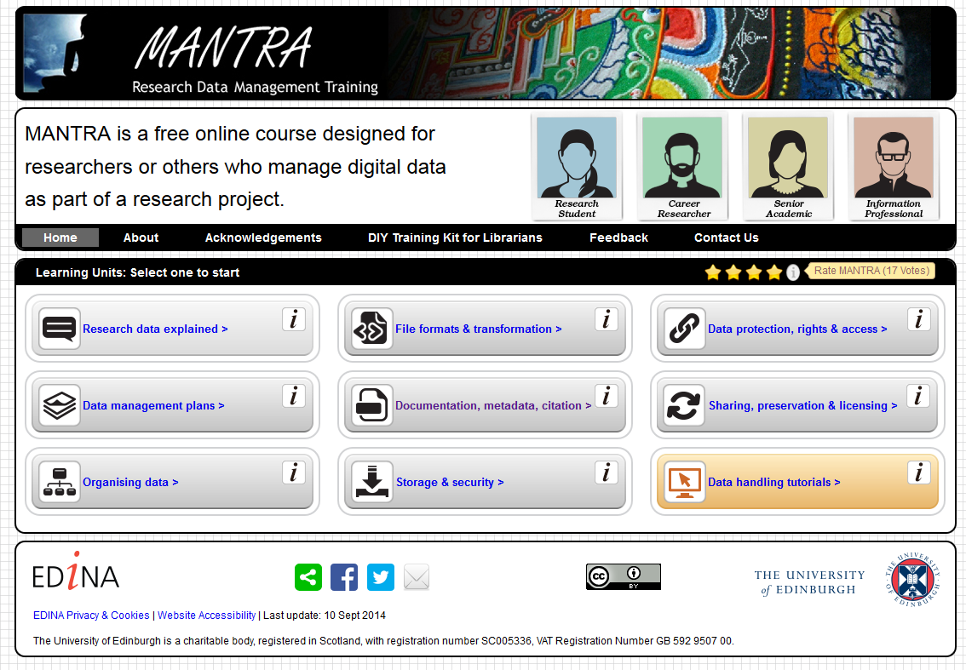

External Resources
Digital Curation Centre – a national service providing advice and resources for the whole data lifecycle
http://www.dcc.ac.uk/
Free online interactive training modules from the University of Edinburgh
http://datalib.edina.ac.uk/mantra/
UK Data Archive - Advice on best practice for creating, preparing, storing and sharing data, in particular social science and humanities data
Notes:
Research Data MANTRA is a series of free interactive online training modules covering key research data management issues.

Slide 9







External Resources
Data journals
Data Repositories

Slide 10
Thank you Any questions?

